Slide 1
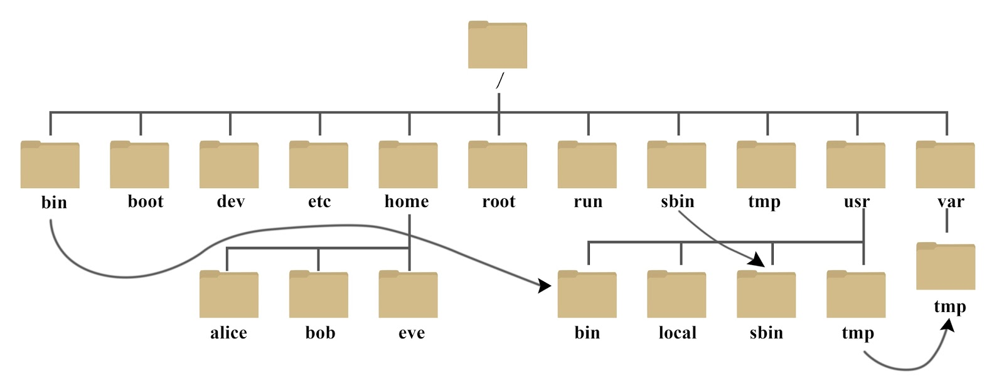
File Hierarchy Standard

Slide 2
File Hierarchy Standard
/bin
/sbin
/tmp
/etc
/usr
/var
/dev
/home

Slide 3
Resources
https://www.youtube.com/watch?v=HbgzrKJvDRw
https://en.wikipedia.org/wiki/Filesystem_Hierarchy_Standard

